Slide 1

Linked Lists C/C++ Comparison
Dr. David J. Coe
Electrical and Computer Engineering Department

Slide 2


Linked List - Overview
A linked list is a type of data structure for maintaining a collection of elements.
The linked list is not stored in contiguous memory and depends on pointers in each element to find the following (and sometimes preceding) elements.

Slide 3
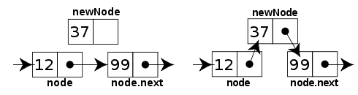
Linked List – Operations - 1
Adding nodes
New nodes can be added anywhere without having to reorganize the existing nodes in memory.

Slide 4
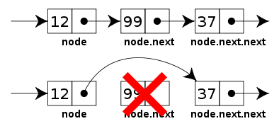
Linked List – Operations - 2
Removing nodes
Nodes can be removed by updating the previous node’s pointer to the node following the deleted node.

Slide 5





Linked List – Operations - 3
Sorting nodes
Nodes can be sorted by having two pointers compare data values and swapping the data values when applicable.

Slide 6
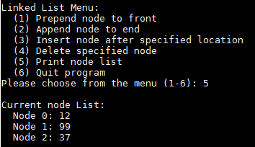
Linked List - Implementation
The following will be a simple example of a singly linked list done in C and C++ for the sake of comparison.

Slide 7

C/C++ - Include Statements
C
C++
Remember the .h
No .h
Could use C library by dropping the .h and preceding with ‘c’ as in #include <cstdio>

Slide 8

C/C++ - Structure Keywords
C
C++
Needs the ‘struct’ keyword when the structure is referenced.
Can be used with typedef to get C++ functionality
Declares the structure the same as in C
Uses the structure name as a new type by default.

Slide 9

C/C++ - Dynamic Memory Allocation
C
C++
Uses malloc and free
Uses new and delete

Slide 10
C/C++ - Basic I/O - 1
C - printf and scanf
C++ - cout and cin
int printMenu(){
int menuChoice = 0;
printf("\nLinked List Menu:\n");
printf(" (1) Prepend node to front\n");
printf(" (2) Append node to end\n");
printf(" (3) Insert node after specified location\n");
printf(" (4) Delete specified node\n");
printf(" (5) Print node list\n");
printf(" (6) Quit program\n");
int scanValue = 0;
while ( scanValue != 1 ){
printf("Please choose from the menu (1-6): ");
scanValue = scanf(" %d", &menuChoice);
if (scanValue != 1){
// error handling for non-integer input
char dummy;
scanf("%c", &dummy);
}
}
return menuChoice;
}
int printMenu(){
int menuChoice = 0;
cout << "\nLinked List Menu:\n";
cout << " (1) Prepend node to front\n";
cout << " (2) Append node to end\n";
cout << " (3) Insert node after specified location\n";
cout << " (4) Delete specified node\n";
cout << " (5) Print node list\n";
cout << " (6) Quit program\n";
cout << "Please choose from the menu (1-6): ";
while ( !(cin >> menuChoice) ){
cout << "Please choose from the menu (1-6): ";
if ( !(cin.good()) ){
cin.clear();
cin.ignore();
}
}
return menuChoice;
}

Slide 11
C/C++ - Basic I/O - 2
C - printf and scanf
C++ - cout and cin
void printList(struct Node *n){
int nodeCount = 0;
printf("\nCurrent node List:\n");
while (n != NULL){
printf(" Node %d: %d\n", nodeCount, n->data);
n = n->next;
nodeCount++;
}
}
void printList(Node *n){
int nodeCount = 0;
cout << "\nCurrent node List:\n";
while (n != NULL){
cout << " Node " << nodeCount << ": "
<< n->data << endl;
n = n->next;
nodeCount++;
}
}

Slide 12
References
“C vs. C++: Some important differences” Florida State University. Retrieved from https://www.cs.fsu.edu/~myers/c++/notes/cdiff.html. Accessed 29 January 2019.
Choudhary, Kamal. “Singly-linked-list” GitHub. Retrieved from https://github.com/kamal-choudhary/singly-linked-list. Accessed 28 January 2019.
“Linked List” Wikipedia. Retrieved from https://en.wikipedia.org/wiki/Linked_list. Accessed 28 January 2019.

